Slide 1
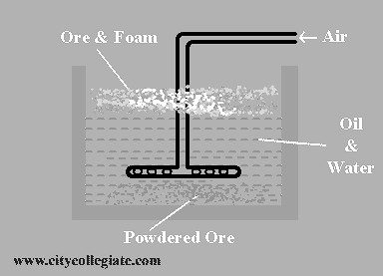
EXTRACTION OF COPPER
IMPORTANT ORES OF COPPER
Copper pyrite or chalcopyrite (CuFeS₂). Chalocite (Cu₂S) or copper glance. Malachite green [CuCO₃.Cu(OH)₂]. Azurite blue [2CuCO₃.Cu(OH)₂]. Bornite (3Cu₂S.Fe2S₃) or peacock ore. Melaconite (CuO) etc.
EXTRACTION OF COPPER FROM SULPHIDE ORE
Large amount of copper are obtained from copper pyrite (CuFeS2) by smelting. Ores containing 4% or more copper are treated by smelting process. Very poor ores are treated by hydro-metallurgical process.
EXTRACTION OF COPPER BY SMELTING PROCESS
Following steps are involved in the extraction of copper. Crashing and Grinding The ore is crushed then ground into powder.
CONCENTRATION
The finely crushed ore is concentrated by Froth-Floatation process. The finely crushed ore is suspended in water containing a little amount of pine oil. A blast of air is passed through the suspension. The particles get wetted by the oil and float as a froth which is skimmed. The gangue (unwanted materials) sinks to the bottom then removed. Productions of 25% approximate Cu containing powder in this stage.

Slide 2
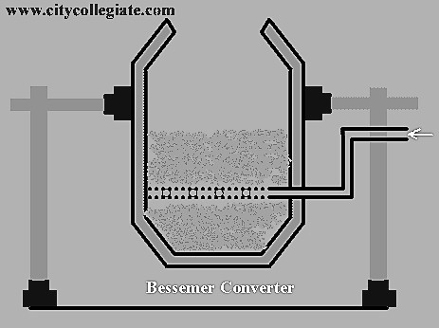
ROASTING
The concentrated ore is then roasted in a furnace between 500ºC and 700ºC in the presence of a current of air. Sulphur is oxidized to SO₂ and impurities of As and Sb are removed as volatile oxides. The following reaction takes place.
2CuFeS₂ + O₂ ➔ Cu₂S + 2FeS + SO₂ S + O₂ ➔ SO₂
4As + 3O₂ ➔ As₂O₃
4Sb + 3O₂ ➔ 2Sb₂O₃
Cuprous sulphide and ferrous sulphide are further oxidized into their oxides.
2Cu₂S + 3O₂ ➔ 2
Cu₂O
+ 2SO₂
2FeS + 3O₂ ➔2
FeO + 2SO₂
SMELTING
The roasted ore is mixed with coke and silica (sand) SiO₂ and is introduced in to a blast furnace with 1200ºC. The hot air is blasted and FeO is converted in to ferrous silicate (FeSiO₃).
FeO + SiO₂ ➔ FeSiO₃ Cu₂O + FeS ➔ Cu₂S + FeO
FeSiO₃ (slag) floats over the molten matte of copper.
A matte of 60%Cu containing has been produced.
BESSEMERIZATION
Copper metal is extracted from molten matte through bessemerization. The matte is introduced in to Bessemer converter which uphold by tuyeres. The air is blown through the molten matte. Blast of air converts Cu₂S partly into Cu₂O which reacts with remaining Cu₂S to give molten copper.
2Cu₂S + 3O₂ ➔ 2Cu₂O + 2SO₂
2Cu₂O + Cu₂S➔ 6Cu + SO₂
The copper so obtained is called "Blister copper" because, as it solidifies, SO₂ hidden in it escapes out producing blister on its surface.

Slide 3
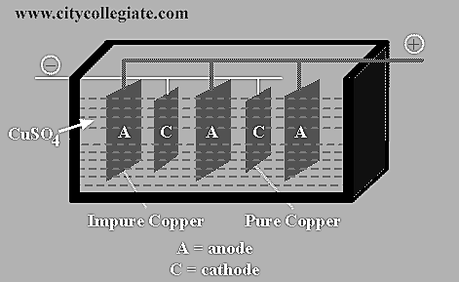
IMPURITIES IN BLISTER COPPER AND THEIR EFFECTS
Blister copper is 99% pure. It contains impurities mainly iron but little amount of As, Zn, Pb, Ag and Au may also be present. These impurities adversely affect the electrical as well as mechanical properties of copper. Therefore, they must be removed.
REFINING OF COPPER
Blister copper is refined by electrolysis. Blocks of blister copper are casted to use as anodes and thin sheets of pure copper act as cathodes. The cathode plates are coated with graphite in order to remove depositing copper. The electrolyte is copper sulphate (CuSO₄) mixed with a little amount of H₂SO₄ to increase the electrical conductivity. Optimum potential difference is 1.3 volt for this electrolytic process. During electrolysis, pure copper (99.99%Cu) is deposited on the cathode plates and impurities which are soluble and fall to the bottom of the cell as anode mud or sludge.
ELECTROCHEMICAL CHANGES DURING ELECTROLYSIS
Cu ➔ Cu⁺² + 2e⁻ (at the anode) Cu⁺² +2e⁻➔ Cu (at the cathode) This electrically refined copper is 100% pure.

